Slide 1
Twitter Stock Market Analysis
- Bhagyalaxmi Nair

Slide 2

Agenda
Introduction
Dataset Description
Objective
Dataset Overview
Tools & Technologies
Methodology
Data Cleaning
Statistical Analysis
Observations
Dashboard Concept
Key Insights
Future Scope
Conclusion

Slide 3

Introduction
This project analyzes the complete stock market journey of Twitter using historical stock data. The analysis covers trends, volatility, statistical testing, and visualization insights.This project analyzes the complete stock market journey of Twitter using historical stock data. The analysis covers trends, volatility, statistical testing, and visualization insights.This project analyzes the complete stock market journey of Twitter using historical stock data. The analysis covers trends, volatility, statistical testing, and visualization insights.This project analyzes the complete stock market journey of Twitter using historical stock data. The analysis covers trends, volatility, statistical testing, and visualization insights.
Twitter is a global microblogging platform
High user engagement but volatile stock performance
Project focuses on historical stock market analysis
Twitter stock market performance analysis
Understanding trends before delisting
Python-based exploratory data analysis

Slide 4
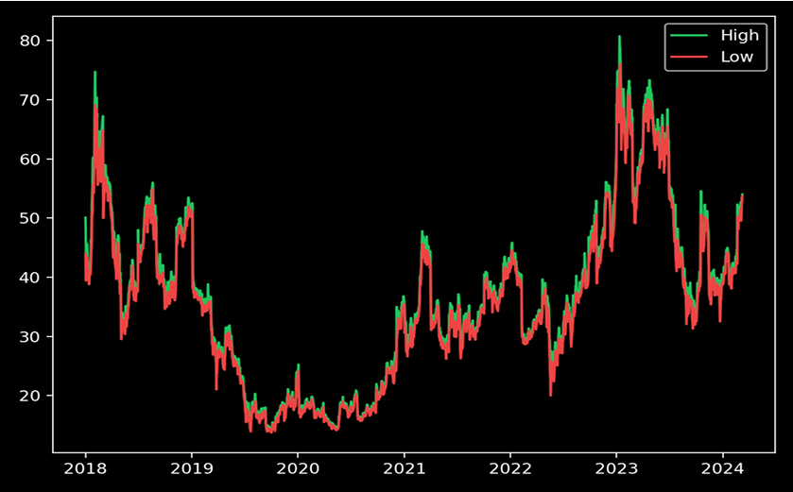
Dataset Description
The dataset contains Date, Open, High, Low, Close, Adjusted Close, and Volume fields representing daily stock performance. The dataset contains Date, Open, High, Low, Close, Adjusted Close, and Volume fields representing daily stock performance. The dataset contains Date, Open, High, Low, Close, Adjusted Close, and Volume fields representing daily stock performance. The dataset contains Date, Open, High, Low, Close, Adjusted Close, and Volume fields representing daily stock performance.

Slide 5
Objective
To understand Twitter's stock behavior, identify trends, perform statistical tests, and derive meaningful insights.To understand Twitter's stock behavior, identify trends, perform statistical tests, and derive meaningful insights.To understand Twitter's stock behavior, identify trends, perform statistical tests, and derive meaningful insights.To understand Twitter's stock behavior, identify trends, perform statistical tests, and derive meaningful insights.
Understand stock price movements
Perform statistical and visual analysis
Derive meaningful insights for decision-making

Slide 6
Dataset Overview
Historical Twitter stock market data
Attributes: Date, Open, High, Low, Close, Adj Close, Volume
Records: 2264
The dataset was loaded using Pandas and the Date column was converted to datetime format. The dataset was loaded using Pandas and the Date column was converted to datetime format. The dataset was loaded using Pandas and the Date column was converted to datetime format. The dataset was loaded using Pandas and the Date column was converted to datetime format.

Slide 7
Tools & Technologies
Python Programming Language
Google Colab
Pandas, NumPy
Matplotlib, Seaborn

Slide 8
Methodology
Python libraries such as Pandas, NumPy, Matplotlib, Seaborn, Plotly, and SciPy were used in Google Colab. Python libraries such as Pandas, NumPy, Matplotlib, Seaborn, Plotly, and SciPy were used in Google Colab. Python libraries such as Pandas, NumPy, Matplotlib, Seaborn, Plotly, and SciPy were used in Google Colab. Python libraries such as Pandas, NumPy, Matplotlib, Seaborn, Plotly, and SciPy were used in Google Colab.
Data loading and inspection
Data cleaning and preprocessing
Exploratory data analysis
Visualization and interpretation

Slide 9
Data Cleaning
Checked for missing/null values
Ensured proper date formatting
Sorted dataset chronologically

Slide 10
Statistical Analysis
Initial inspection involved viewing top rows, understanding data types, and structure. Initial inspection involved viewing top rows, understanding data types, and structure. Initial inspection involved viewing top rows, understanding data types, and structure. Initial inspection involved viewing top rows, understanding data types, and structure.
Calculated mean, median, standard deviation
Helped understand data distribution and volatility

Slide 11
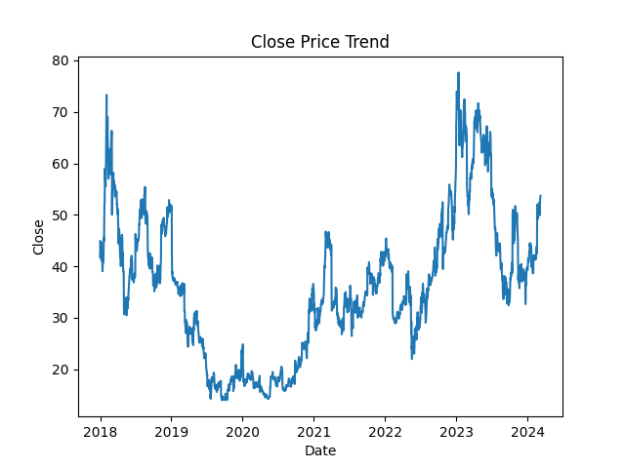
Close Price Trend Analysis

Slide 12

Open Price Trend Analysis

Slide 13
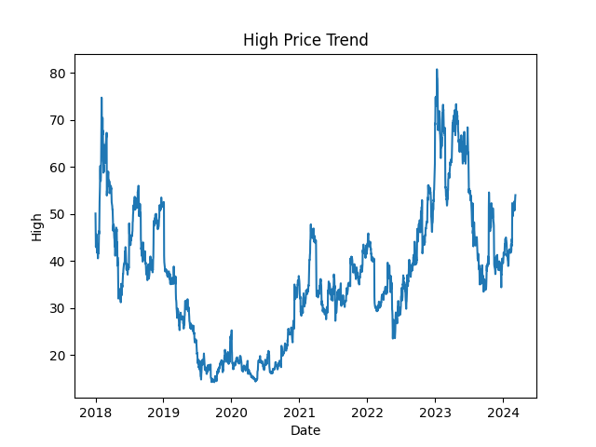
High Price Trend Analysis

Slide 14

Low Price Trend Analysis

Slide 15
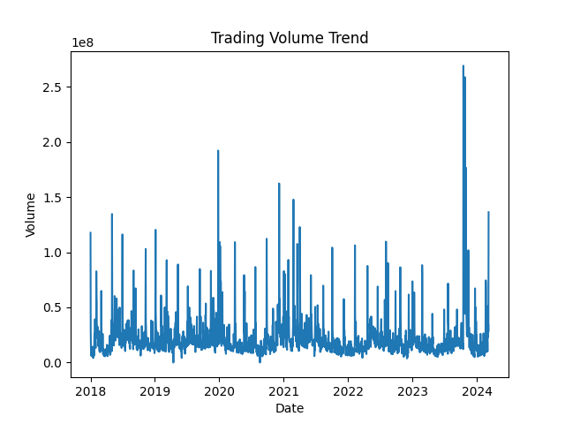
Trading Volume Analysis

Slide 16
Trend Observations
Frequent fluctuations indicate high volatility
Price instability increased during later periods
Each column was analyzed for meaning, range, and data type. Each column was analyzed for meaning, range, and data type. Each column was analyzed for meaning, range, and data type. Each column was analyzed for meaning, range, and data type.
Null Value Analysis
The dataset was checked for missing values and cleaned appropriately. The dataset was checked for missing values and cleaned appropriately. The dataset was checked for missing values and cleaned appropriately. The dataset was checked for missing values and cleaned appropriately.

Slide 17
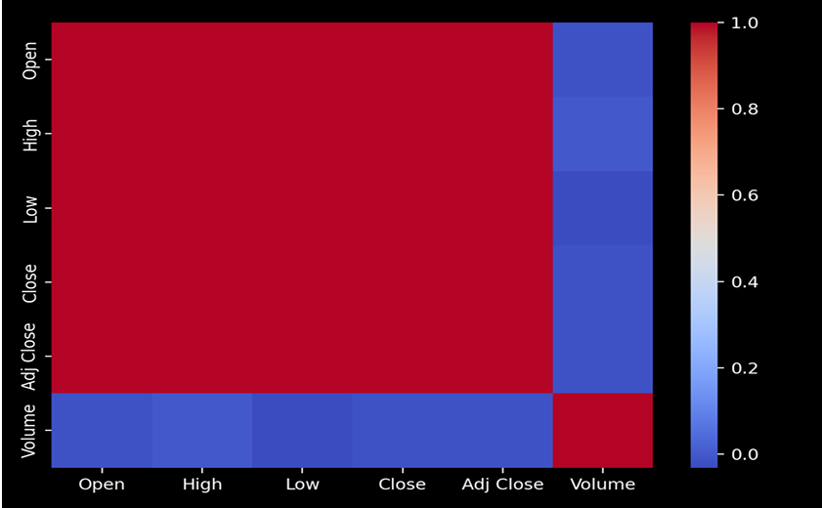
Timeline Analysis
Early growth followed by unstable movement
Market uncertainty before delisting phase
Statistical Summary
Mean, median, standard deviation, min, and max values were calculated. Mean, median, standard deviation, min, and max values were calculated. Mean, median, standard deviation, min, and max values were calculated. Mean, median, standard deviation, min, and max values were calculated.

Slide 18
Analysis
T-Test Analysis T-tests were performed between High, Low, and Close prices to test mean differences. T-tests were performed between High, Low, and Close prices to test mean differences. T-tests were performed between High, Low, and Close prices to test mean differences. T-tests were performed between High, Low, and Close prices to test mean differences. Chi-Square Test Chi-square test was used to determine dependency between volume and price categories. Chi-square test was used to determine dependency between volume and price categories. Chi-square test was used to determine dependency between volume and price categories. Chi-square test was used to determine dependency between volume and price categories.

Slide 19
Stock Price Trend Analysis
Line charts were used to visualize stock prices over time. Line charts were used to visualize stock prices over time. Line charts were used to visualize stock prices over time. Line charts were used to visualize stock prices over time. Close Price Analysis Close price trends reveal volatility and major fluctuations. Close price trends reveal volatility and major fluctuations. Close price trends reveal volatility and major fluctuations. Close price trends reveal volatility and major fluctuations. Timeline Analysis Complete stock timeline from IPO to delisting was visualized. Complete stock timeline from IPO to delisting was visualized. Complete stock timeline from IPO to delisting was visualized. Complete stock timeline from IPO to delisting was visualized. Volume Analysis Trading volume spikes correspond with major price changes. Trading volume spikes correspond with major price changes. Trading volume spikes correspond with major price changes. Trading volume spikes correspond with major price changes.

Slide 20
Word Cloud Analysis Word cloud summarizes key analytical terms. Word cloud summarizes key analytical terms. Word cloud summarizes key analytical terms. Word cloud summarizes key analytical terms. Advanced Analysis Seasonality and correlation analysis can enhance insights. Seasonality and correlation analysis can enhance insights. Seasonality and correlation analysis can enhance insights. Seasonality and correlation analysis can enhance insights. Correlation Analysis Correlation heatmap highlights relationships between stock variables. Correlation heatmap highlights relationships between stock variables. Correlation heatmap highlights relationships between stock variables. Correlation heatmap highlights relationships between stock variables. Correlation heatmap highlights relationships between stock variables. Volatility Insights High volatility observed during acquisition and delisting periods. High volatility observed during acquisition and delisting periods. High volatility observed during acquisition and delisting periods. High volatility observed during acquisition and delisting periods.

Slide 21
Dashboard Concept
Interactive time-period filters
Stock price comparison charts
Volume-based insights
A Python-based dashboard integrates multiple visual insights. A Python-based dashboard integrates multiple visual insights. A Python-based dashboard integrates multiple visual insights. A Python-based dashboard integrates multiple visual insights.

Slide 22
Key Insights
Strong brand did not ensure stable stock growth
Volume spikes aligned with sharp price movements
Business Insights Twitter stock showed uncertainty before delisting. Twitter stock showed uncertainty before delisting. Twitter stock showed uncertainty before delisting. Twitter stock showed uncertainty before delisting.

Slide 23
Business Interpretation
Market sentiment plays a key role
Stock performance impacted by external events

Slide 24
Limitations
Only historical price data used
No real-time or sentiment data included
No external macroeconomic factors considered. No external macroeconomic factors considered. No external macroeconomic factors considered. No external macroeconomic factors considered.

Slide 25
Future Scope
Machine learning-based price prediction
Sentiment analysis using Twitter posts
Comparative market analysis
Machine learning models can predict future trends. Machine learning models can predict future trends. Machine learning models can predict future trends. Machine learning models can predict future trends.

Slide 26
Conclusion
Twitter stock showed long-term volatility
Python-based analysis provided clear insights
Twitter stock showed unstable trends
Significant fluctuations before delisting
Data-driven insights achieved
The analysis provides a comprehensive understanding of Twitter's stock lifecycle. The analysis provides a comprehensive understanding of Twitter's stock lifecycle. The analysis provides a comprehensive understanding of Twitter's stock lifecycle. The analysis provides a comprehensive understanding of Twitter's stock lifecycle. Client Value Helps investors understand Twitter stock behavior. Helps investors understand Twitter stock behavior. Helps investors understand Twitter stock behavior. Helps investors understand Twitter stock behavior.

Slide 27


